Slide 1
AI AGENTS
THE FUTURE OF INTELLIGENT AUTOMATION

Slide 2
Agenda
What is an AI Agent?
How AI Agents Work - The Basic Loop
2025 - The Year of AI Agents
Benefits of Agents
Types of AI Agents
Agentic AI vs Generative AI
Google Jules
GitHub Copilot

Slide 3
What is an AI Agent?
Definition: Task-oriented software that autonomously performs actions, using an LLM, to achieve goals.
Core Characteristics:
  Autonomy - Operates independently with minimal supervision
  Perception - Understands and interprets its environment
  Reasoning - Makes decisions based on information
  Action - Takes concrete steps to achieve objectives
  Learning - Improves performance through experience
Key Distinction: Unlike traditional software, AI agents adapt, plan, and make decisions in dynamic environments

Slide 4
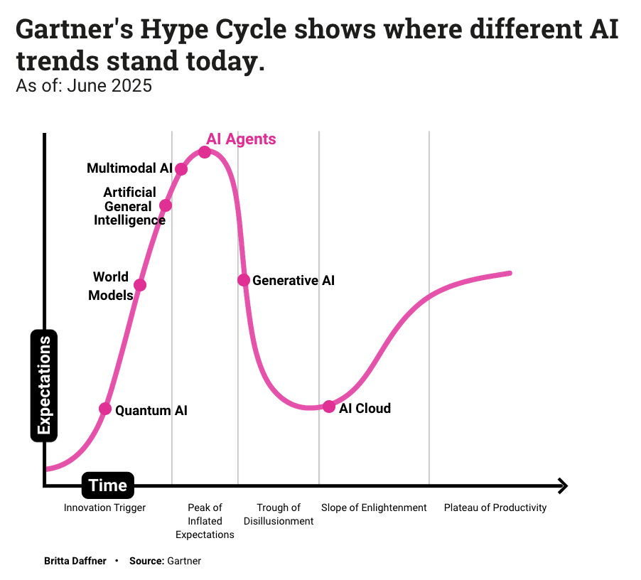
Hype Cycle
Why are we talking about AI Agents?

Slide 5
2025 - The Year of AI Agents
Market Impact: 99% of 1,000 developers surveyed are exploring or developing AI agents (IBM)
Market Growth: $5.1B (2024) → $47.1B (2030) at 44.8% CAGR
Industry Adoption:
  72% of medium/large enterprises currently use agentic AI
  21% plan to adopt within two years
  Expected to resolve 80% of customer service issues by 2029
Andrej Karpathy (OpenAI founder, ex-Tesla AI lead): "This will be the decade of AI agents"

Slide 6
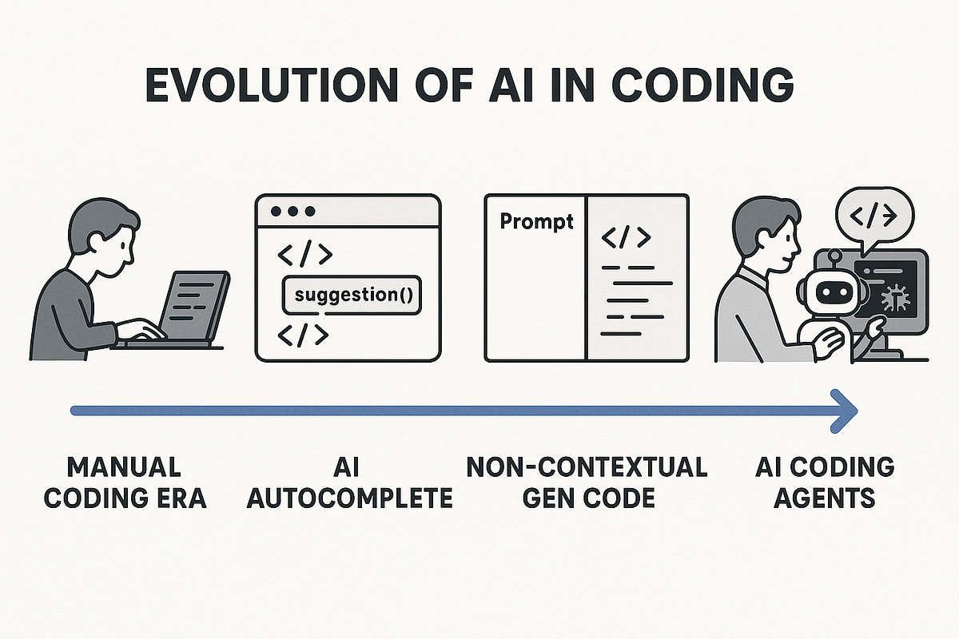

Slide 7
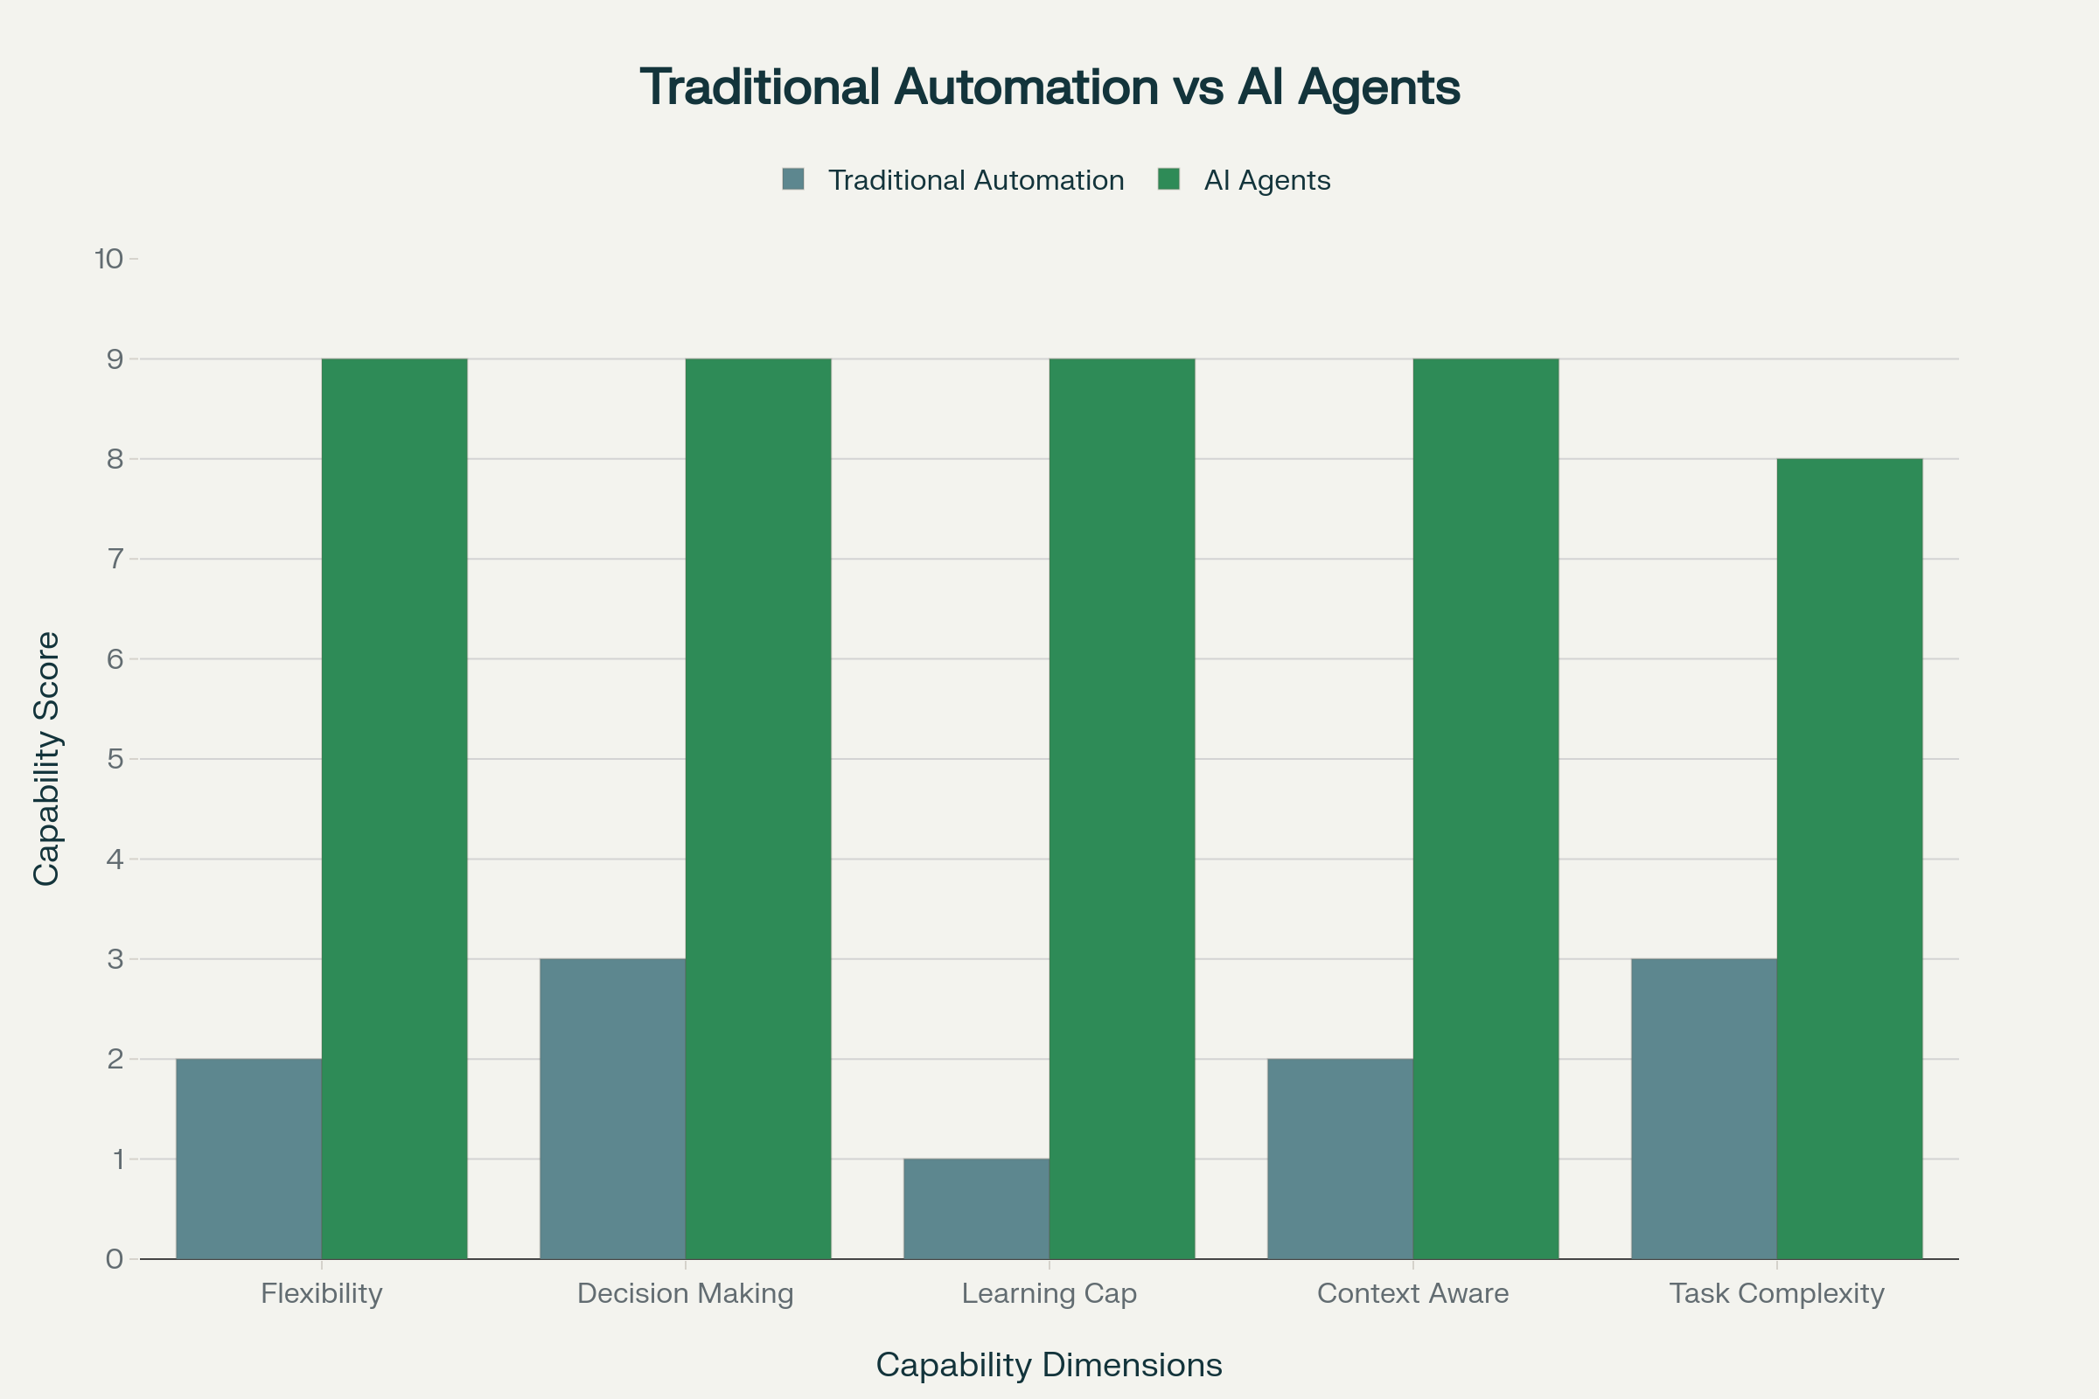
Agentic AI versus Traditional Automation
Traditional automation follows predetermined rules and workflows—if X happens, do Y. These systems excel at repetitive, structured tasks with clear decision trees but break when processes change.
Agentic AI receives goals rather than instructions and determines how to achieve those goals through reasoning, planning, and adaptive execution. Agents handle ambiguity by asking clarifying questions, adapt to changing conditions by replanning when initial approaches fail, and learn from experience to improve future performance.
Key differences include:​
Intelligence and decision-making: Automation executes predefined logic; agents make autonomous, context-aware decisions.​
Learning and adaptation: Automation requires manual updates to change behavior; agents learn from interactions and adjust automatically.​
Flexibility: Automation is rigid and breaks when inputs vary from expectations; agents handle novel situations by reasoning through problems.​
Scope: Automation excels at narrow, repetitive tasks; agents tackle complex, dynamic challenges requiring judgment.​
This doesn't mean agents replace automation entirely—rather, forward-thinking organizations use both strategically. Traditional automation handles high-volume, deterministic tasks where consistency and speed matter most (data entry, scheduled reports, simple integrations), while agents address areas requiring judgment, personalization, and adaptation (customer support, research, complex workflow optimization).

Slide 8
Benefits of Agents
Accelerated Software Development: Agents help with coding, debugging, and documentation, speeding up development cycles and maintaining code quality.
Increased Team Productivity: Automate routine tasks, manage schedules, and optimize workflows, freeing up team members for creative and strategic work.
Faster Information Analysis: Agents handle large data amounts, extract key insights, and create summaries quickly, enabling faster data-driven decisions.
Improved Data Quality and Consistency: Automatically process and enrich data, reducing manual data entry errors.
Enhanced Customer Experience: Agents speed up response times, handle basic inquiries, and provide 24/7 support.

Slide 9
Types of AI Agents
Simple Reflex Agents - React to current conditions only (e.g., spam filters)
Model-Based Agents - Maintain internal state/memory (e.g., navigation systems)
Goal-Based Agents - Work toward specific objectives (e.g., route optimization)
Utility-Based Agents - Maximize outcome quality (e.g., financial portfolio managers)
Learning Agents - Improve over time, adapt to new situations (e.g., Netflix/Spotify recommendations)

Slide 10
Agentic AI vs Generative AI
Purpose: Generative AI creates content | Agentic AI takes actions and completes tasks
Input: Generative AI requires explicit prompts | Agentic AI infers tasks from context
Output: Generative AI produces static responses | Agentic AI performs dynamic actions
Autonomy: Generative AI needs direction | Agentic AI operates independently
Examples: ChatGPT, DALL-E (Generative) | Virtual assistants, autonomous agents (Agentic)
Key Insight: Generative AI tools require human prompting; Agentic AI plans, reasons, and acts with minimal oversight

Slide 11
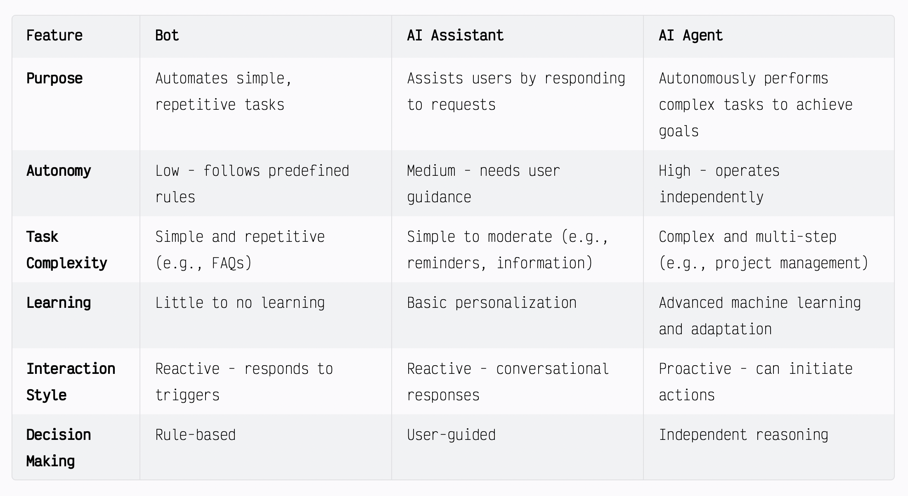
Distinguishing AI agents from bots and assistants

Slide 12
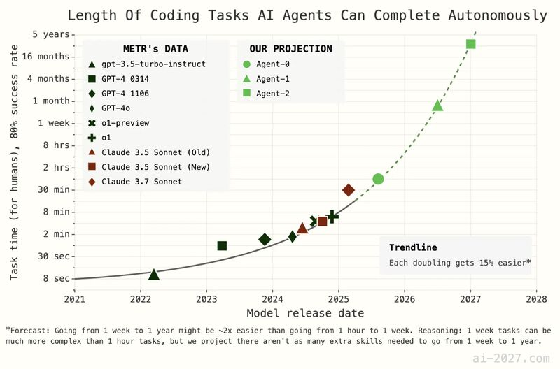

Slide 13
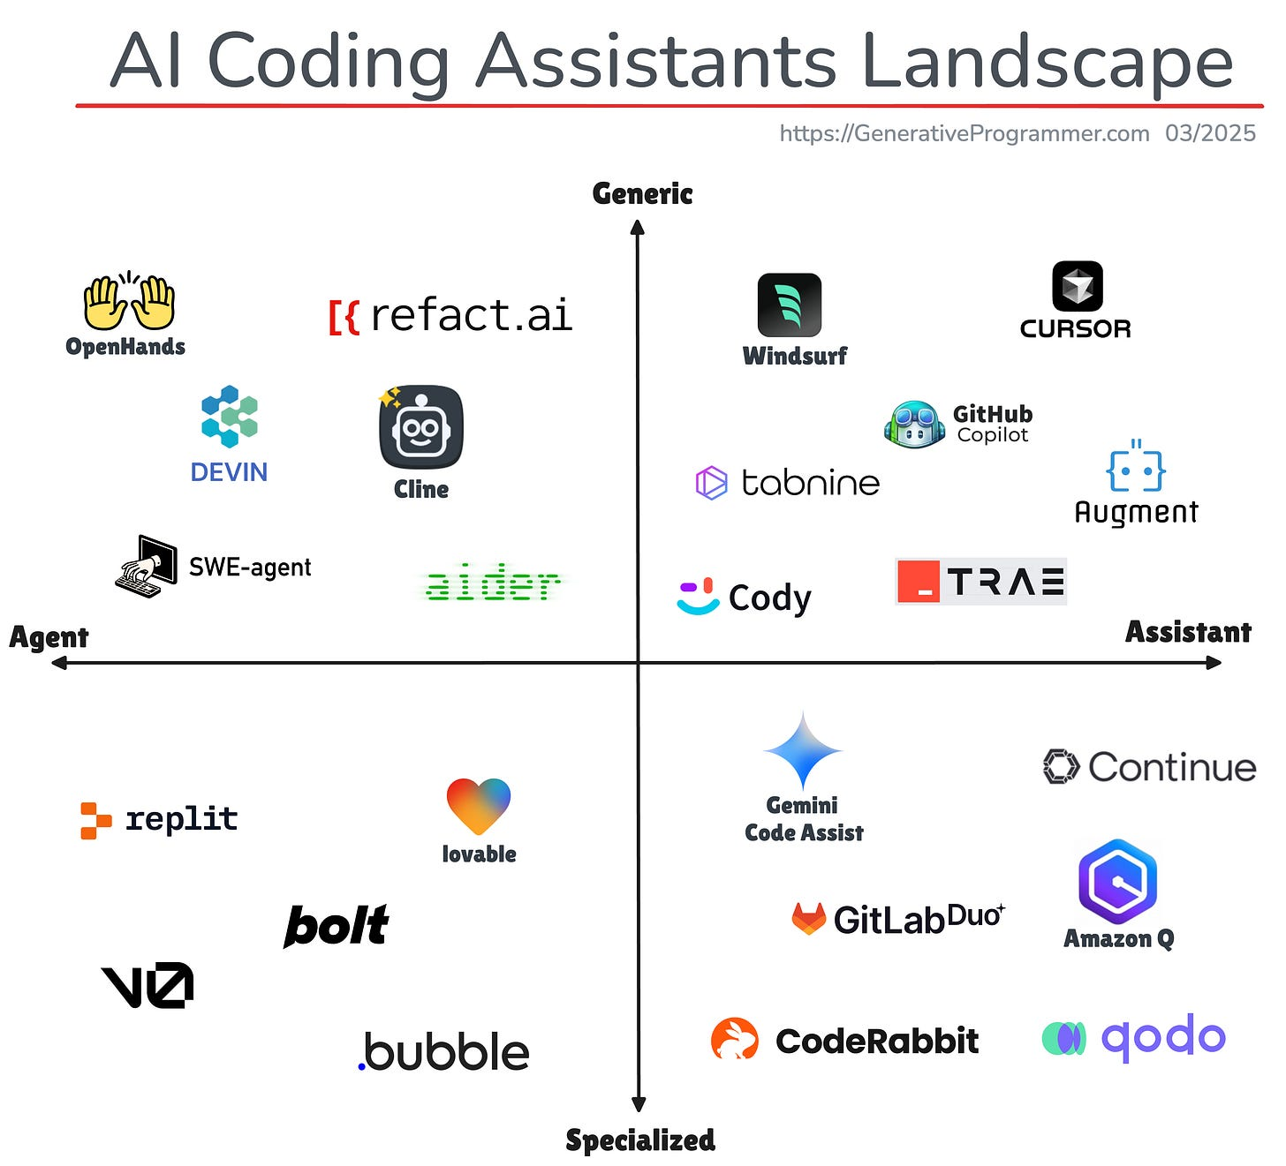

Slide 14
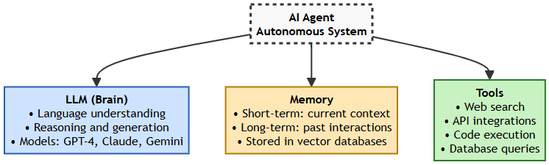
Core Components of AI Agents
LLM (Brain)
  Language understanding and generation
  GPT-4, Claude, Gemini models
Memory
  Short-term: Current conversation/task
  Long-term: Past interactions, learned knowledge
  Stored in vector databases
Tools
  Web search capabilities
  API integrations
  Code execution
  Database queries

Slide 15
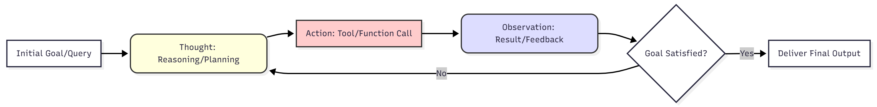
AI Agent Autonomous Workflow (The ReAct Framework)
This flowchart visualizes the dynamic, iterative Thought-Action-Observation loop, which is central to enabling autonomous problem-solving in modern agents
The agent starts with a Goal and begins an iterative cycle.
It first generates a Thought, which is verbalized reasoning or planning (task decomposition).
This leads to an Action (invoking a tool, executing code). The result is an Observation (feedback from the environment).
If the Goal is Satisfied, the agent delivers the Final Output; otherwise, the observation informs the next Thought, restarting the loop. This dynamic planning allows agents to adapt to unexpected obstacles.

Slide 16
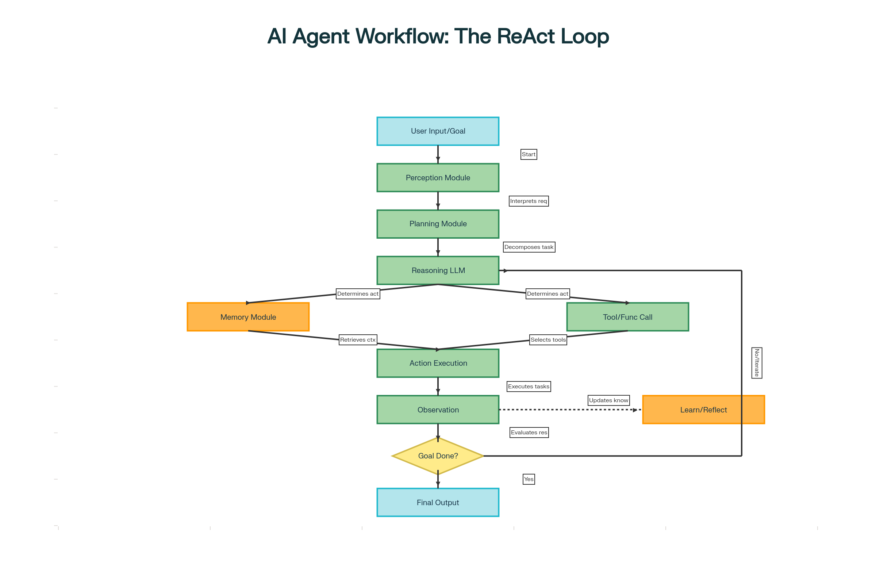

Slide 17
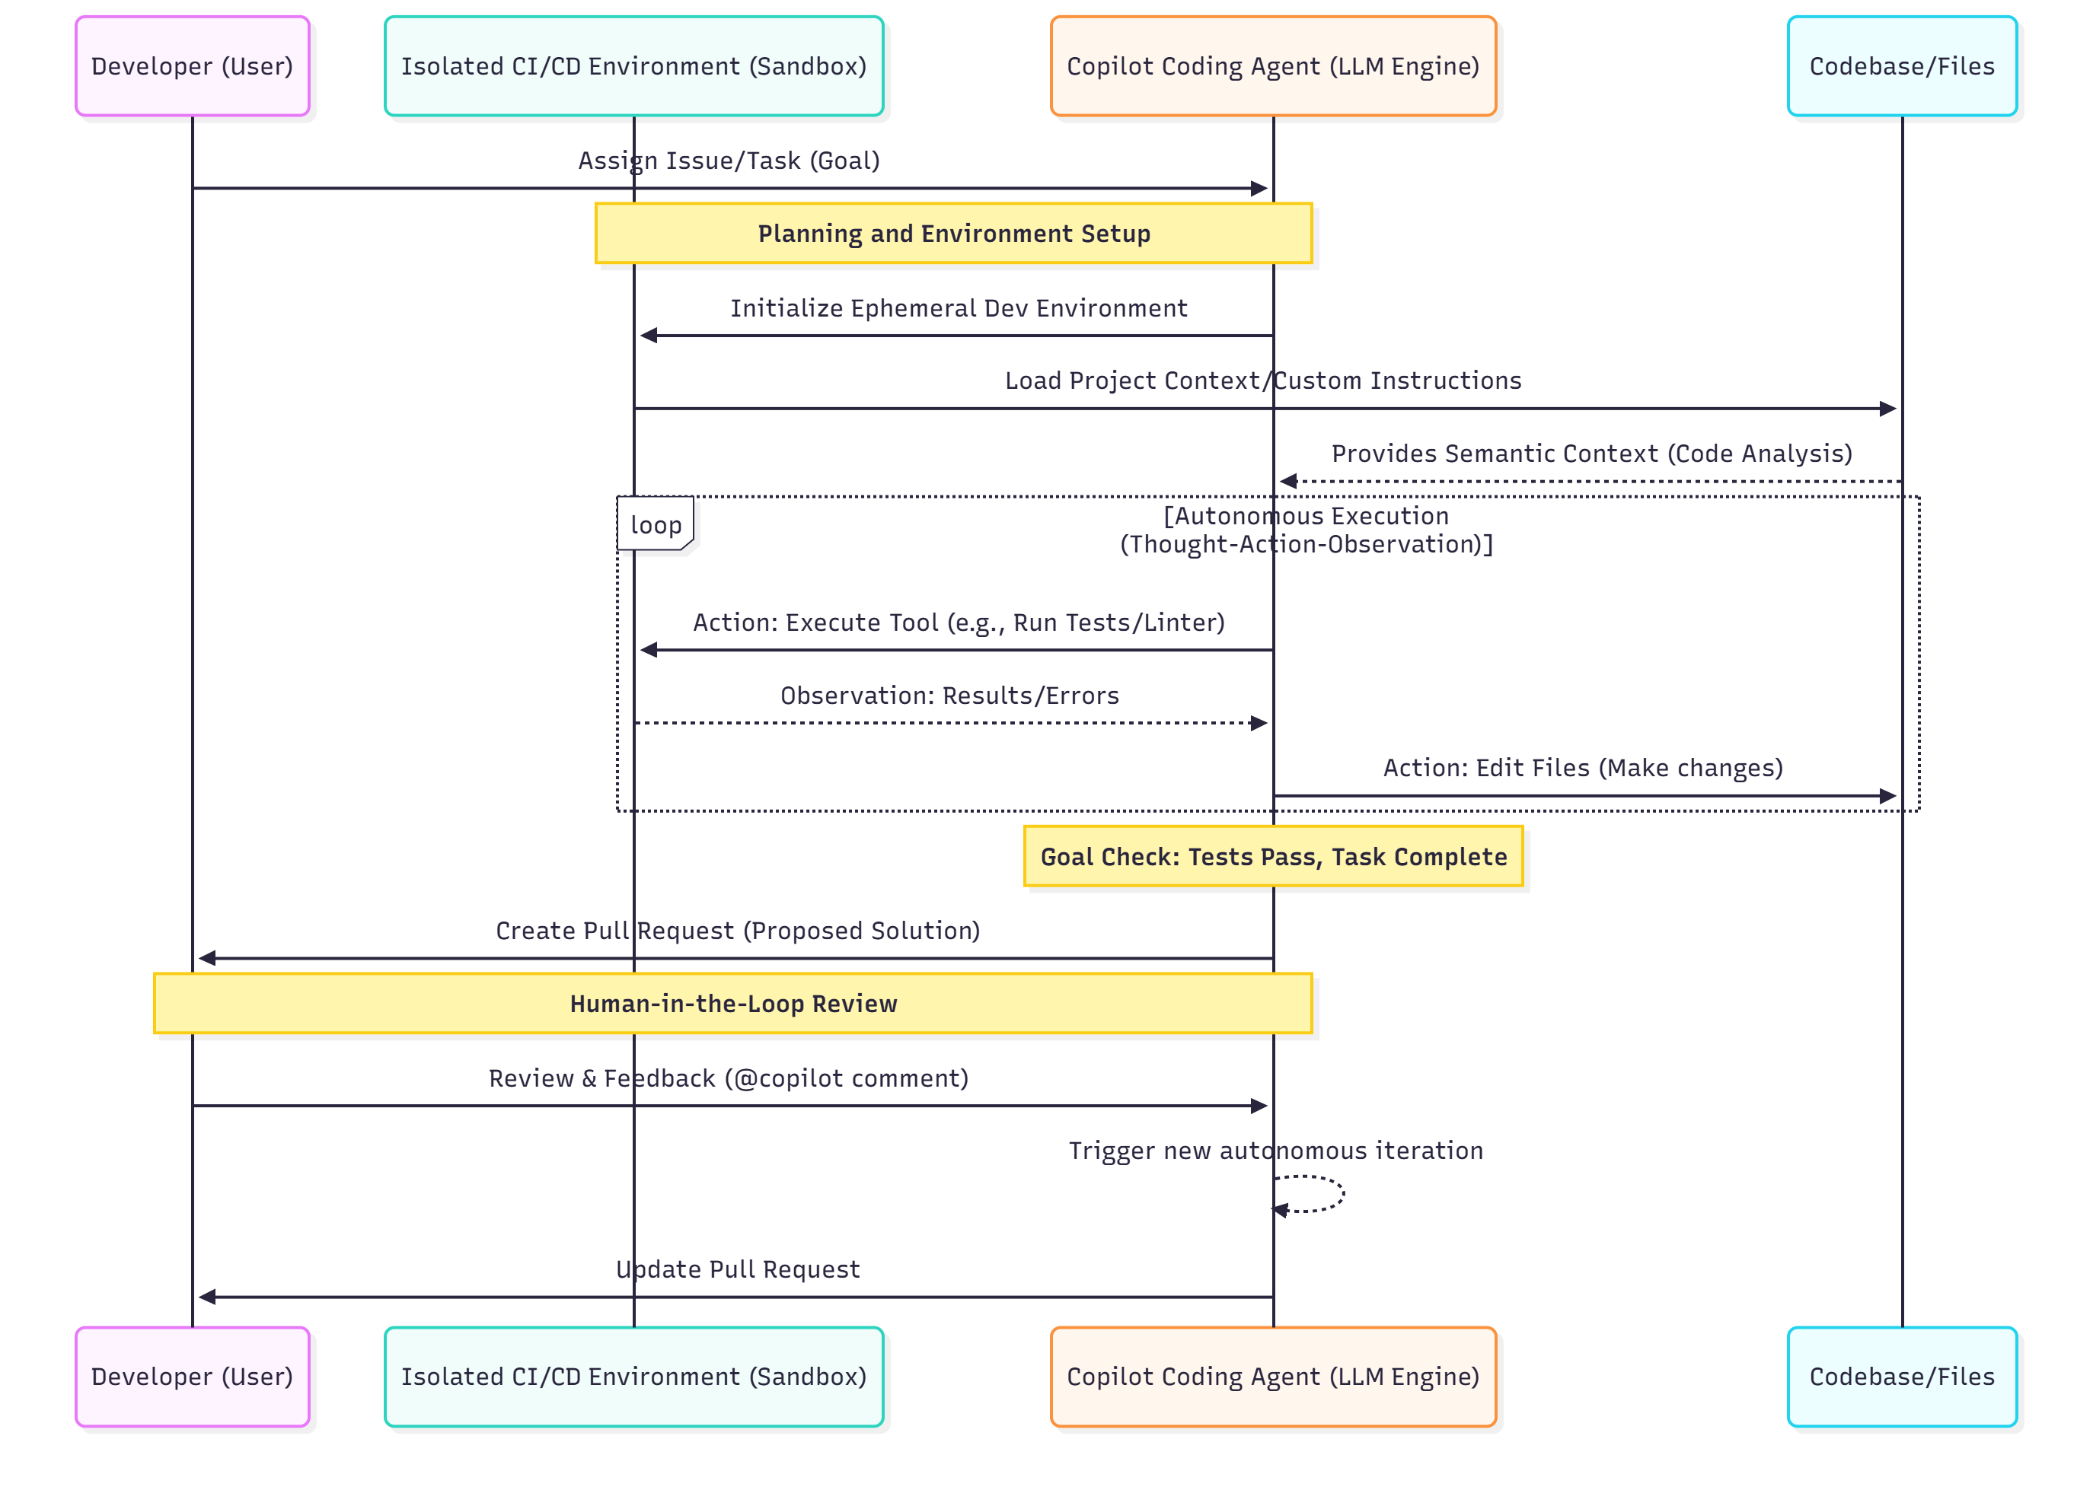
GitHub Copilot Coding Agent Workflow (Autonomous Mode)
The Developer (User) assigns a well-scoped Issue/Task (the goal) to the agent.
The Copilot Agent initializes an Isolated CI/CD Environment (often powered by GitHub Actions). It gathers context, including repository-wide instructions (e.g., copilot-instructions.md) and performs code analysis.
The agent enters a Self-Correction Loop where it performs Actions (running tests or making file edits) and processes the Observations (results/errors) to refine its plan.
Once complete, the agent creates a Pull Request (PR) for the human.

Slide 18

Google Jules
Jules - An Asynchronous Coding Agent
Google Jules is a cutting-edge, autonomous AI agent developed by Google that is positioned as a significant countermeasure to the dominance of GitHub Copilot in the software development domain.
Jules is specifically designed to redefine workflow automation by operating asynchronously, thereby reducing the context switching burden on developers

Slide 19
Google Jules - Core Architecture and Model
Foundation Model: Jules is powered by Google's Gemini 2.5 Pro model. This model demonstrates high-level reasoning capabilities, making it ideal for complex feature implementation and refactoring.
Context and Knowledge: Jules has a large context window of 256K tokens. It integrates internal documentation using Knowledge Graph Integration to incorporate project context. Knowledge updates are handled through real-time learning.
Engine Design: The agent relies on a Jules Async Engine which uses an event-driven architecture with dynamic task prioritization.

Slide 20
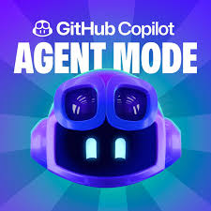
GitHub Copilot Coding Agent
The GitHub Copilot Coding Agent features an autonomous execution mode that runs in the cloud, specifically utilizing a GitHub Actions-powered environment. This operational mode allows the agent to handle entire software development issues from start to finish, working asynchronously in the background while the developer focuses on other tasks.

Slide 21
GitHub Copilot coding agent's cloud-based operation
1. Environment and Execution
Isolated CI Environment: The agent operates in an isolated CI environment, often described as a GitHub Actions-powered environment or a secure sandbox. This isolation allows the agent to safely execute plans, write code, and run tests.
Purpose of Cloud Execution: This specific mode handles entire issues from start to finish. It is designed to function as an additional team member capable of addressing technical debt, bug fixes, and straightforward feature implementation asynchronously.
Autonomy: In this mode, the Copilot agent is capable of autonomous edits across multiple files, analyzing code, running tests, and validating results. It plans the work, writes code, runs tests, and ultimately opens pull requests (PRs) for human review.

Slide 22
GitHub Copilot coding agent's cloud-based operation
2. Workflow and Task Management
Goal Assignment: Developers assign GitHub issues directly to Copilot. An ideal task assigned to the agent should be clear and well-scoped, including a precise description of the problem, complete acceptance criteria (e.g., whether unit tests are required), and directions about which files need changing. The assigned issue effectively serves as the prompt for the agent.
Asynchronous Operation: The agent operates asynchronously. This contrasts with its synchronous inline completion and chat modes. The asynchronous nature allows the agent to handle maintenance work and small-to-medium features that do not require immediate completion, enabling developers to assign tasks and return later to completed pull requests.
Handling Dependencies: The agent uses an ephemeral development environment where it can explore the code and make changes. To ensure reliability, developers can configure a copilot-setup-steps.yml file to pre-install project dependencies before the agent starts working, as relying on the LLM to discover and install them via trial and error can be slow and unreliable.
Custom Instructions: Developers can provide custom instructions to guide the agent on how to understand the project and how to build, test, and validate its changes. These can be provided in files like .github/copilot-instructions.md in the repository root or path-specific instruction files.

Slide 23
GitHub Copilot coding agent's cloud-based operation
3. Key Architectural Support
Model Context Protocol (MCP): A key architectural innovation is the support for the Model Context Protocol (MCP). This protocol allows the Copilot coding agent to connect to external data sources and tools beyond GitHub’s native capabilities. This means the agent can access documentation, query internal APIs, or access proprietary knowledge bases, functioning like an onboarded team member. The GitHub MCP server and Playwright MCP server are enabled by default.
Action Execution: After planning, the agent's actions include executing tools like running tests or linters, and performing edits across multiple files.
Human-in-the-Loop: Once the agent creates a Pull Request (PR), developers can provide feedback by mentioning @copilot in comments on the PR. When a user with write access mentions @copilot, the agent will initiate the required changes and update the PR, ensuring human oversight is maintained.
This asynchronous, cloud-based mode positions the Copilot Coding Agent as a powerful tool for automating systematic improvements and maintenance work, freeing developers to focus on higher-priority feature development.

